Slide 1

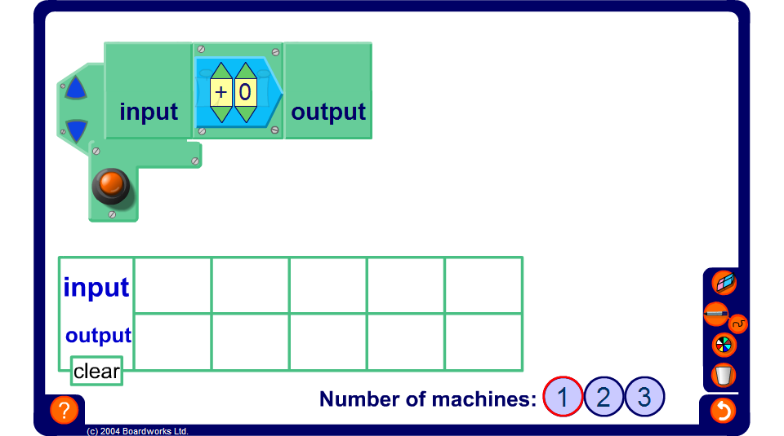


Recording inputs and outputs in a table
Notes:
Use this activity to demonstrate how functions can be entered into a table.
Ask pupils,
How could we show this function as a graph?
Establish that each value we have chosen for x and the corresponding value for y, form a coordinate pair. Plotting these coordinates would give us a graph of the function.

